Slide 1
C++ Programming:
From Problem Analysis to Program Design, Sixth Edition
Chapter 9: Records (structs)

Slide 2
Objectives
In this chapter, you will:
Learn about records (structs)
Examine various operations on a struct
Explore ways to manipulate data using a struct
Learn about the relationship between a struct and functions
Discover how arrays are used in a struct
Learn how to create an array of struct items

Slide 3
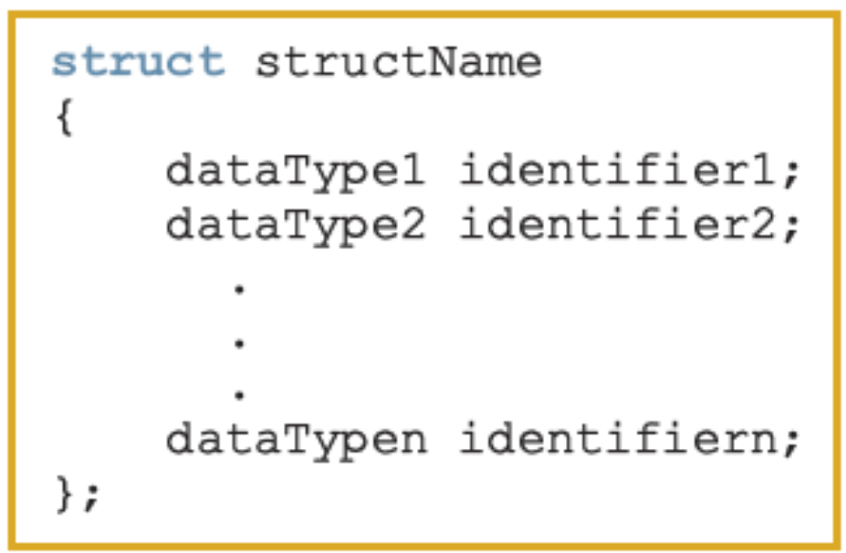
Records (structs)
struct: collection of a fixed number of components (members), accessed by name
A struct is a definition, not a declaration
  Members may be of different types
Syntax:

Slide 4
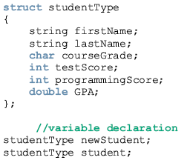
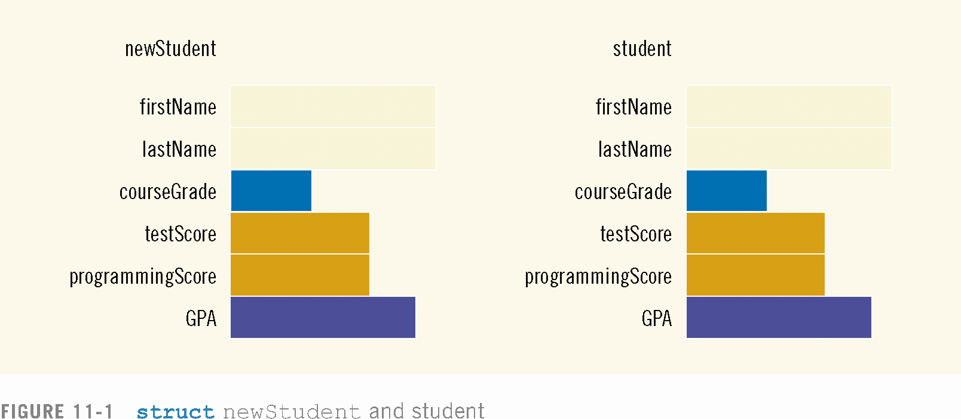

Slide 5
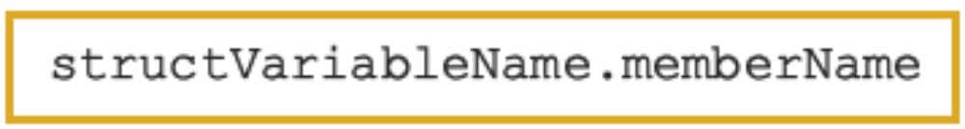
Accessing struct Members
The syntax for accessing a struct member is:
The dot (.) is an operator, called the member access operator

Slide 6
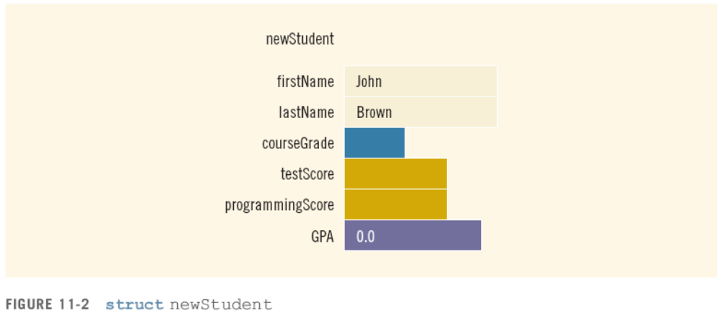
Accessing struct Members (continued)
To initialize the members of newStudent:
  newStudent.GPA = 0.0;
  newStudent.firstName = "John";
  newStudent.lastName = "Brown";

Slide 7
Accessing struct Members (continued)
  More examples:
  cin >> newStudent.firstName;
  cin>>newStudent.testScore>>newStudent.programmingScore;
  score = (newStudent.testScore + newStudent.programmingScore) / 2;
  if (score >= 90)
  newStudent.courseGrade = 'A';
  else if (score >= 80)
  newStudent.courseGrade = 'B';
  else if (score >= 70)
  newStudent.courseGrade = 'C';
  else if (score >= 60)
  newStudent.courseGrade = 'D';
  else
  newStudent.courseGrade = 'F';

Slide 8
Assignment
Value of one struct variable can be assigned to another struct variable of the same type using an assignment statement
The statement:
student = newStudent;
copies the contents of newStudent into student
Prepared by: Malak Abdullah----C++ Programming: From Problem Analysis to Program Design, Fifth Edition

Slide 9
Assignment (continued)
The assignment statement:
student = newStudent;
is equivalent to the following statements:
student.firstName = newStudent.firstName;
student.lastName = newStudent.lastName;
student.courseGrade = newStudent.courseGrade;
student.testScore = newStudent.testScore;
student.programmingScore = newStudent.programmingScore;
student.GPA = newStudent.GPA;

Slide 10
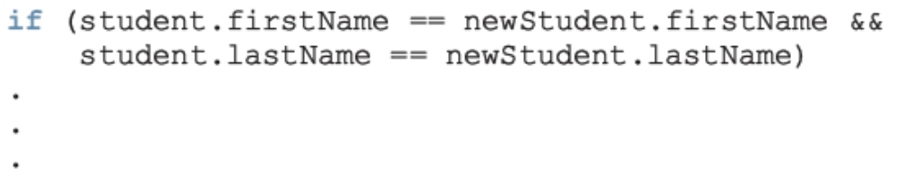
Comparison (Relational Operators)
Compare struct variables member-wise
  No aggregate relational operations allowed
To compare the values of student and newStudent:

Slide 11
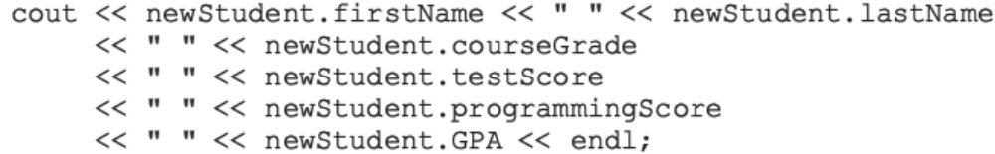
Input/Output
No aggregate input/output operations on a struct variable
Data in a struct variable must be read one member at a time
The contents of a struct variable must be written one member at a time

Slide 12
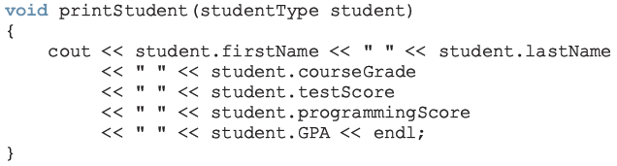
struct Variables and Functions
A struct variable can be passed as a parameter by value or by reference
A function can return a value of type struct

Slide 13
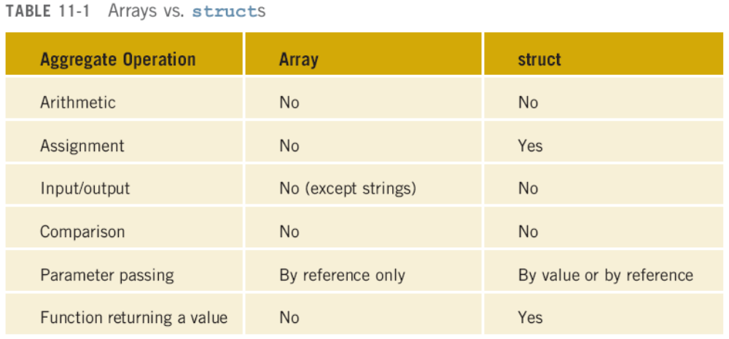
Arrays versus structs

Slide 14
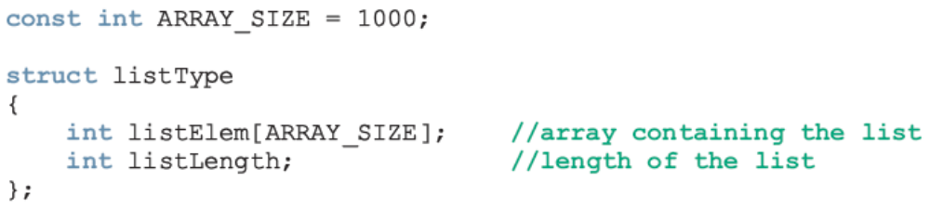
Arrays in structs
Two key items are associated with a list:
  Values (elements)
  Length of the list
Define a struct containing both items:

Slide 15
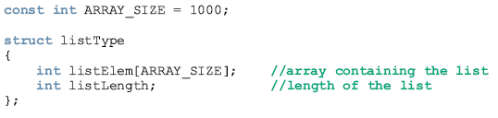
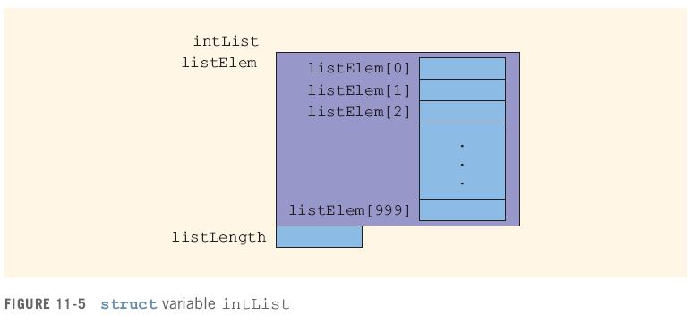
Arrays in structs [Cont.]
Prepared by: Malak Abdullah----C++ Programming: From Problem Analysis to Program Design, Fifth Edition

Slide 16

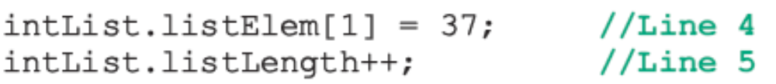
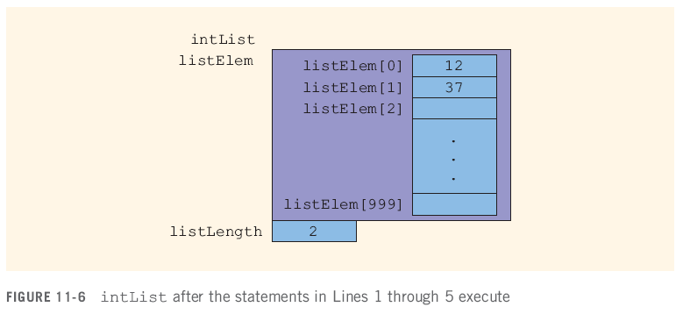
Arrays in structs (cont'd.)

Slide 17
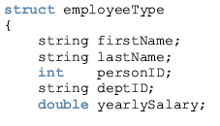

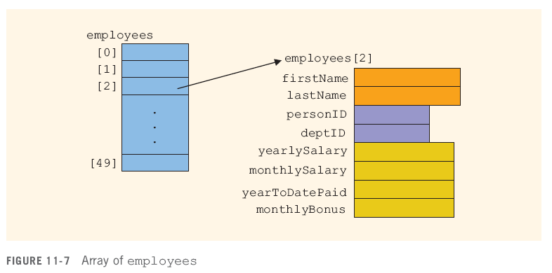
Arrays of structs

Slide 18
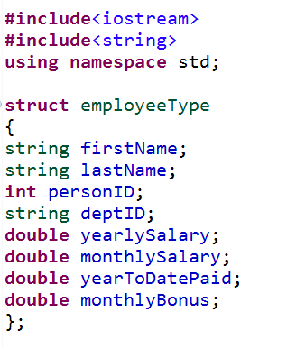
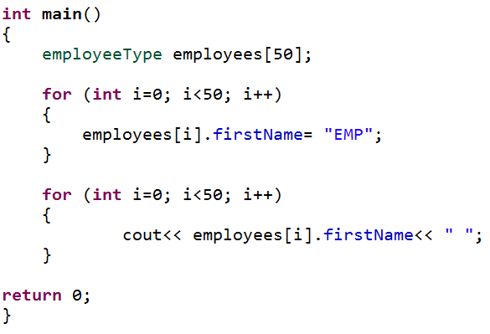
Arrays of structs [Cont.]

Slide 19
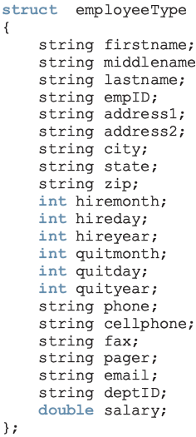
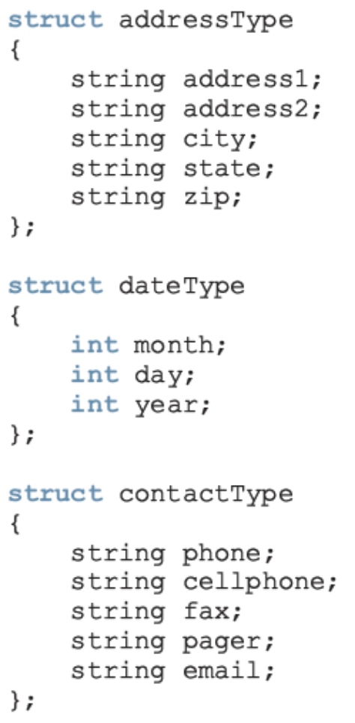
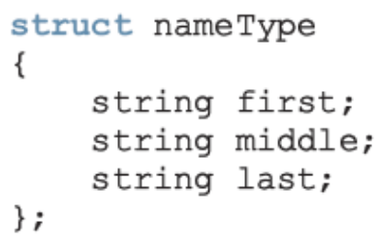
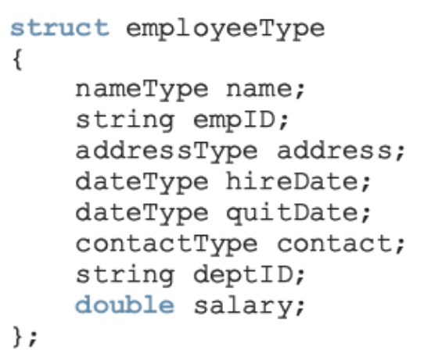
structs within a struct
versus

Slide 20
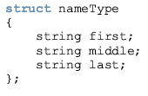
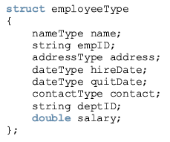
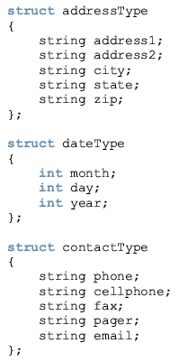
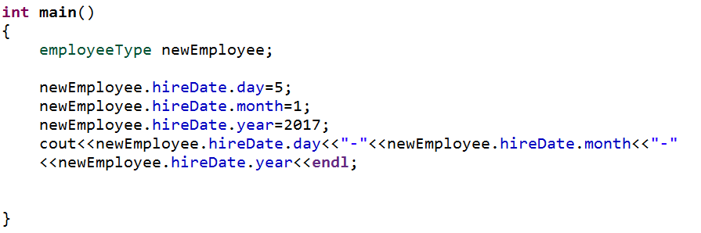

Slide 21

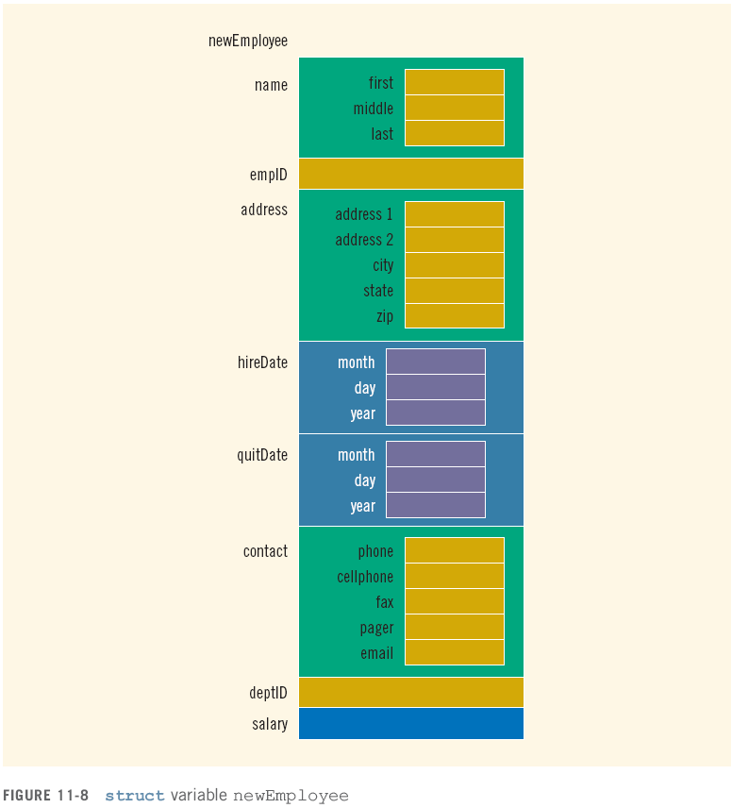

Slide 22
The End

